Slide 1
EagleSat 2: Implementation of Improved Communications Systems on UHF Steven Buck Dr. Gary Yale, Embry-Riddle Aeronautical University Arizona Space Grant Consortium Symposium April 14, 2018

Slide 2
Outline
EagleSat-1 communications
Reason for improvement
Transceiver improvement
Antenna improvements
Additional improvements
EagleSat-2 communications
Ground station improvements
Results

Slide 3
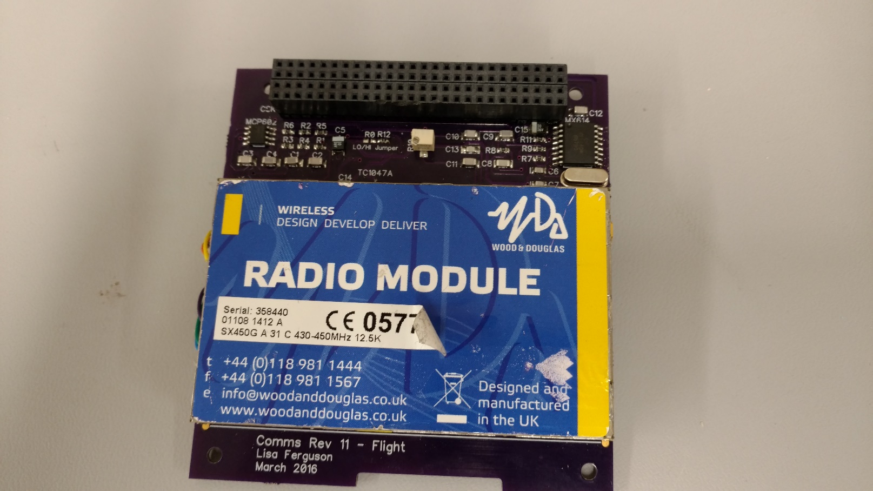
EagleSat-1 Communications
437.645 MHz
0.5 W transmit power
9600 baud AX.25
Monopole .87 dBi gain

Slide 4
Reason for Improvement
Expected 30 Mb of data per pass
Each pass approximately 7 minutes
Needs more reliability and robustness

Slide 5
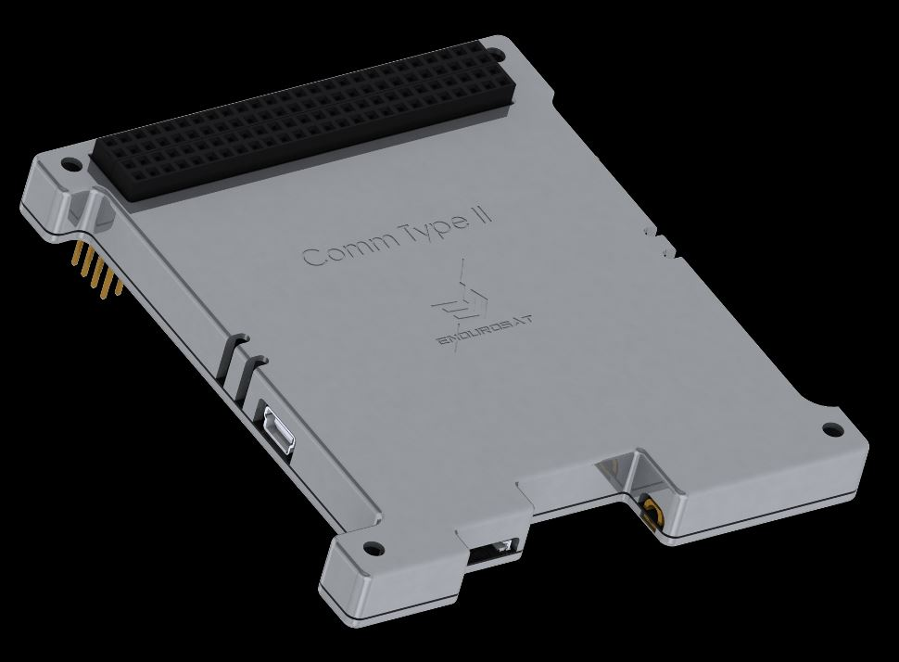
Transceiver Improvement
Endurosat UHF transceiver
1 W transmit power
Specified 100 kbps over air data rate
Cost $7000

Slide 6
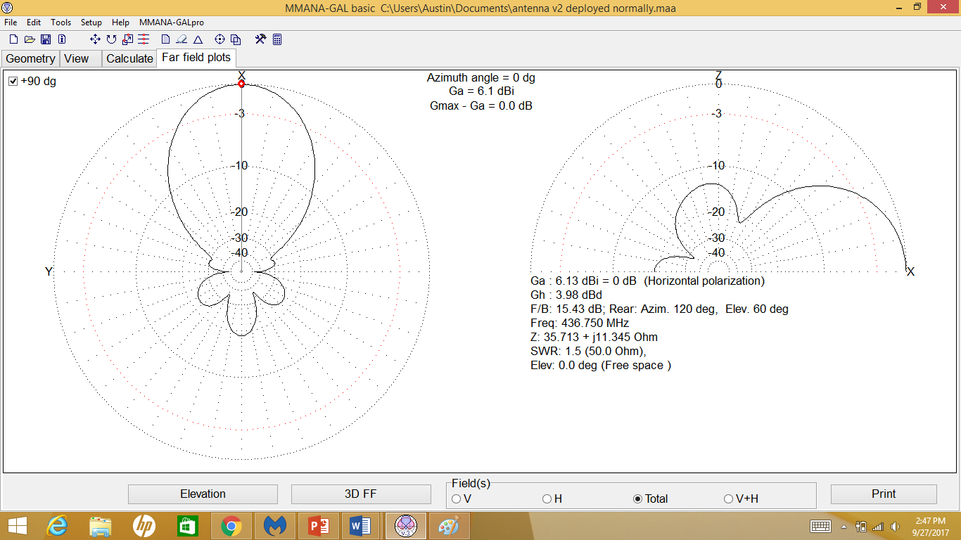
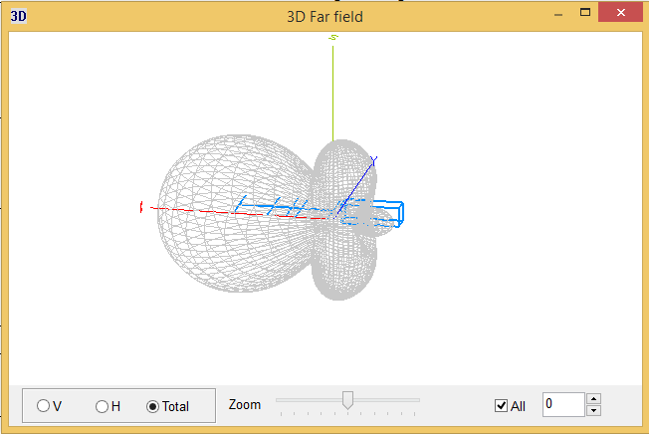
Antenna Improvements
Dual antenna system
Directional antenna for data downlink
Monopole for backup communications

Slide 7
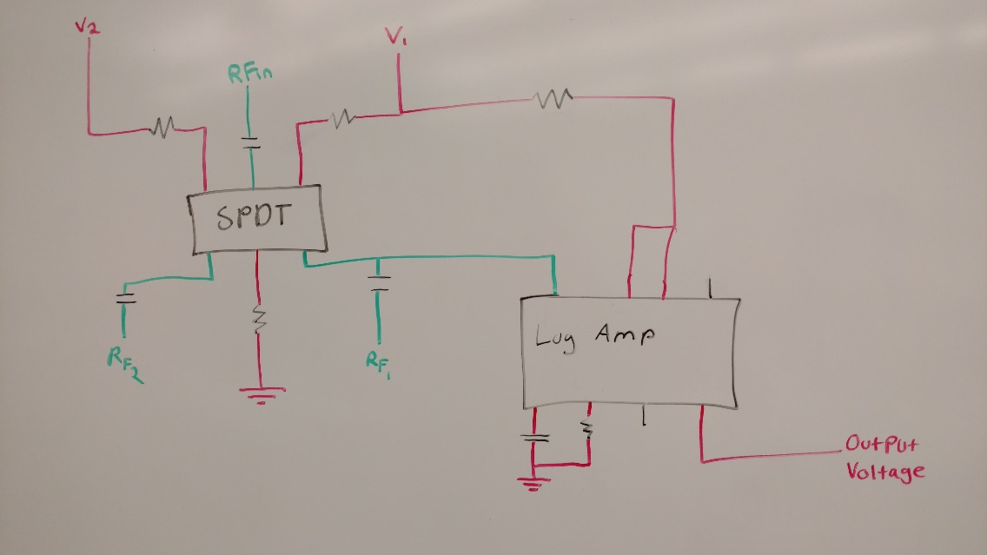
Additional Improvements
A method to switch antenna to prevent interference
Using an GAAS MMIC SPDT switch designed for RF signals
A method to assist with antenna pointing
Using the AD8307 Logarithmic Amplifier

Slide 8
EagleSat-2 Communications
UHF frequencies
1 W transmit power
Max 100 kbps using AX.25
Monopole antenna with .87 dBi gain
Directional antenna with approximately 6 dBi gain

Slide 9
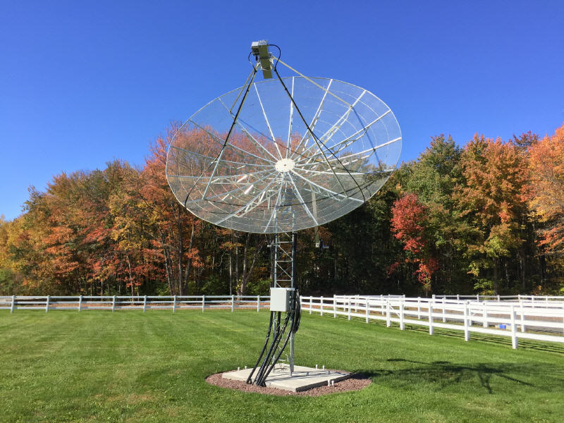
Ground Station Improvements
4.5m mesh dish antenna
Wide bandwidth transceiver

Slide 10
Results
Preliminary switching tests are promising
Signal strength output voltage changes with received power
Eb/No, S/N have 17.1dB at horizon

Slide 11
Acknowledgements
Dr. Gary Yale, Embry-Riddle Aeronautical University
TeamXC, NASA Jet Propulsion Laboratory
Travis Imken, NASA Jest Propulsion Laboratory

Slide 12
Thank You

